Slide 1
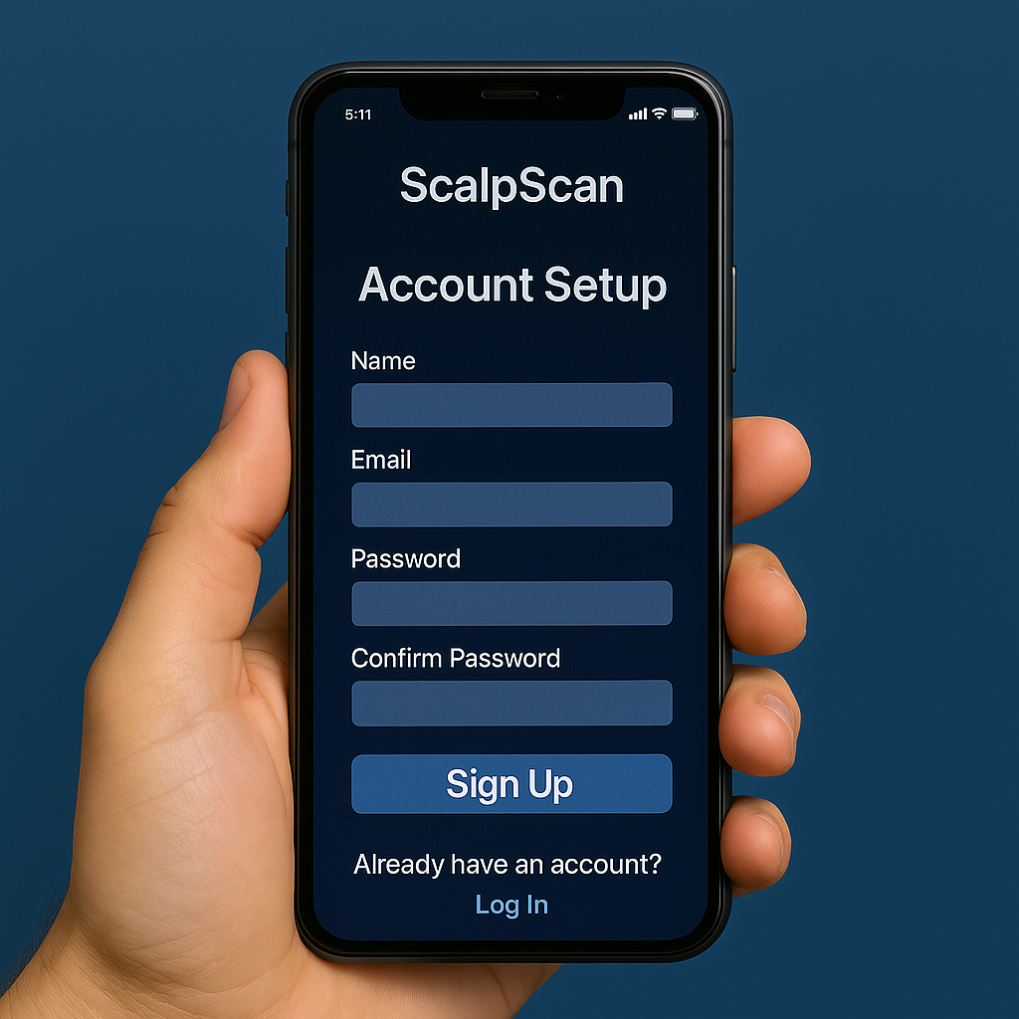
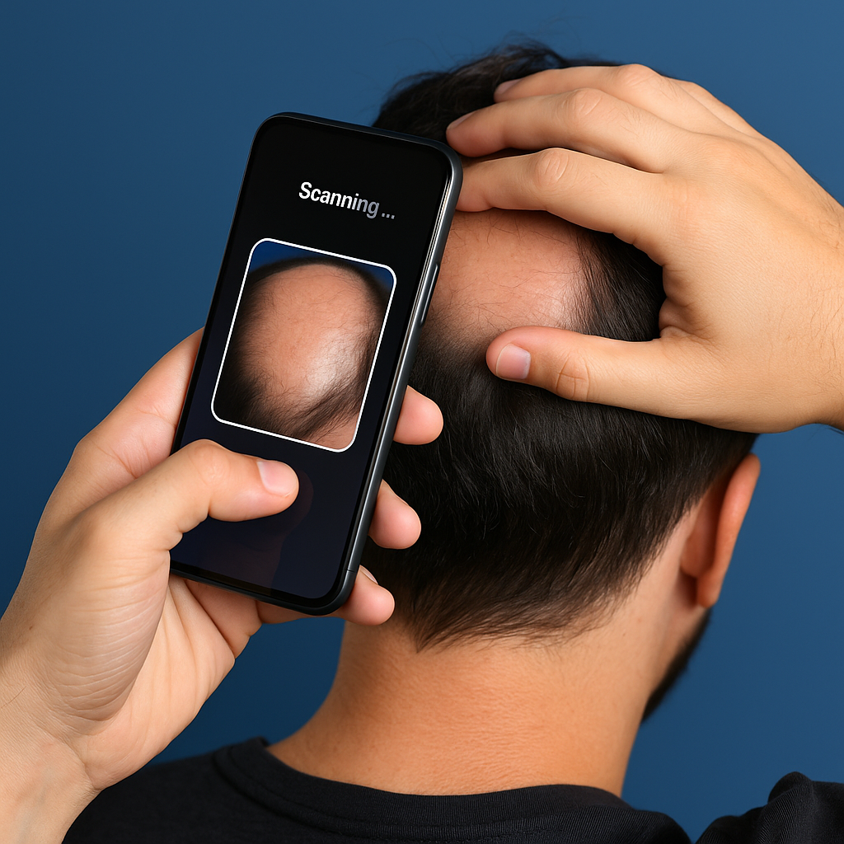
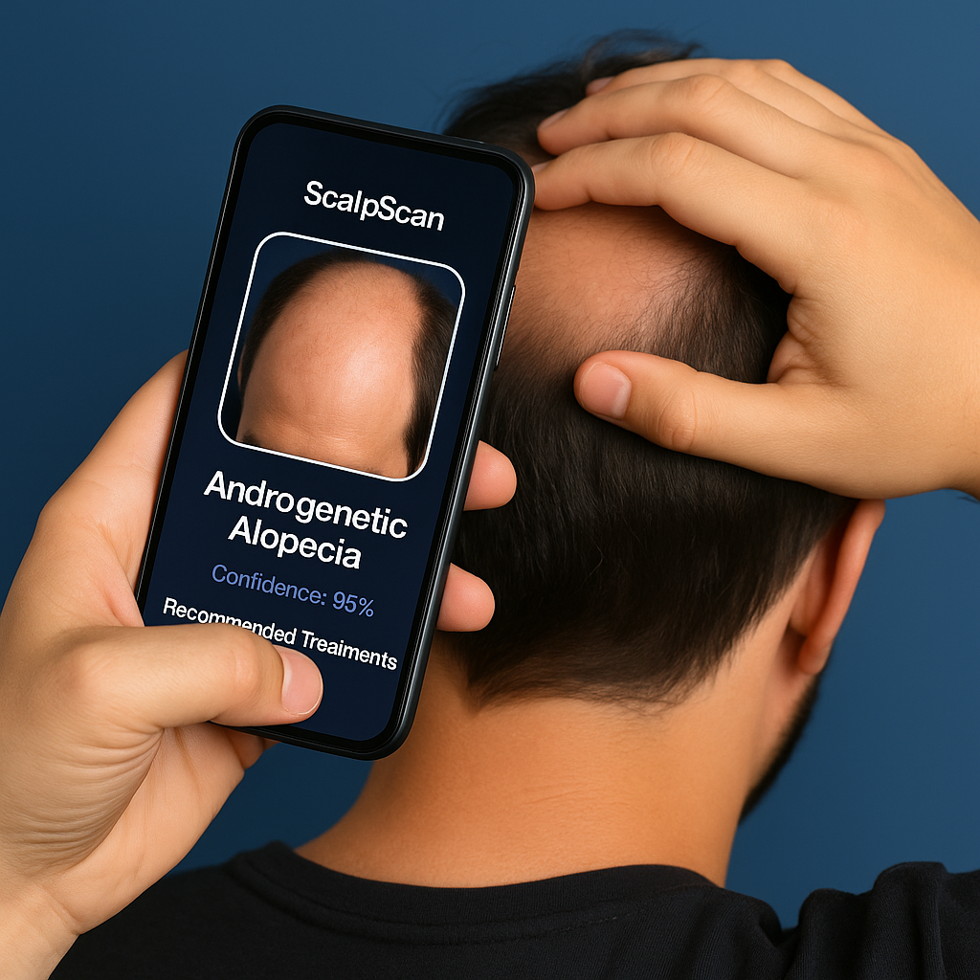
ScalpScan Mobile App: AI-Powered Scalp Health and Early Alopecia Detection
Project Creator : Shakera Rush
Original Creator: Tirthraj Mahajan ScalpSmart/.gitignore at main · pblgroupproject/ScalpSmart
"Detect, Track, and Restore Your Hair Health with AI."
Step 3: Retrieve AI Diagnosis & Recommended treatment plan
Step 1: Account Setup
Step 2: Scan Scalp
Notes:
Hair loss is a common issue affecting millions worldwide, with different forms of alopecia requiring specific treatments. Many individuals struggle to identify their condition accurately, leading to delays in proper care. ScalpScan is an innovative mobile application designed to scan the scalp using a smartphone camera and AI-driven image analysis to determine different types of alopecia. The app will provide instant assessments, treatment recommendations, and connections to dermatologists or hair specialists for further consultation.

